Slide 1
An investigation into unfinished housing estates in Ireland
source: https://data.gov.ie/dataset
DATA8008
Teresa Quain, R00017812

Slide 2
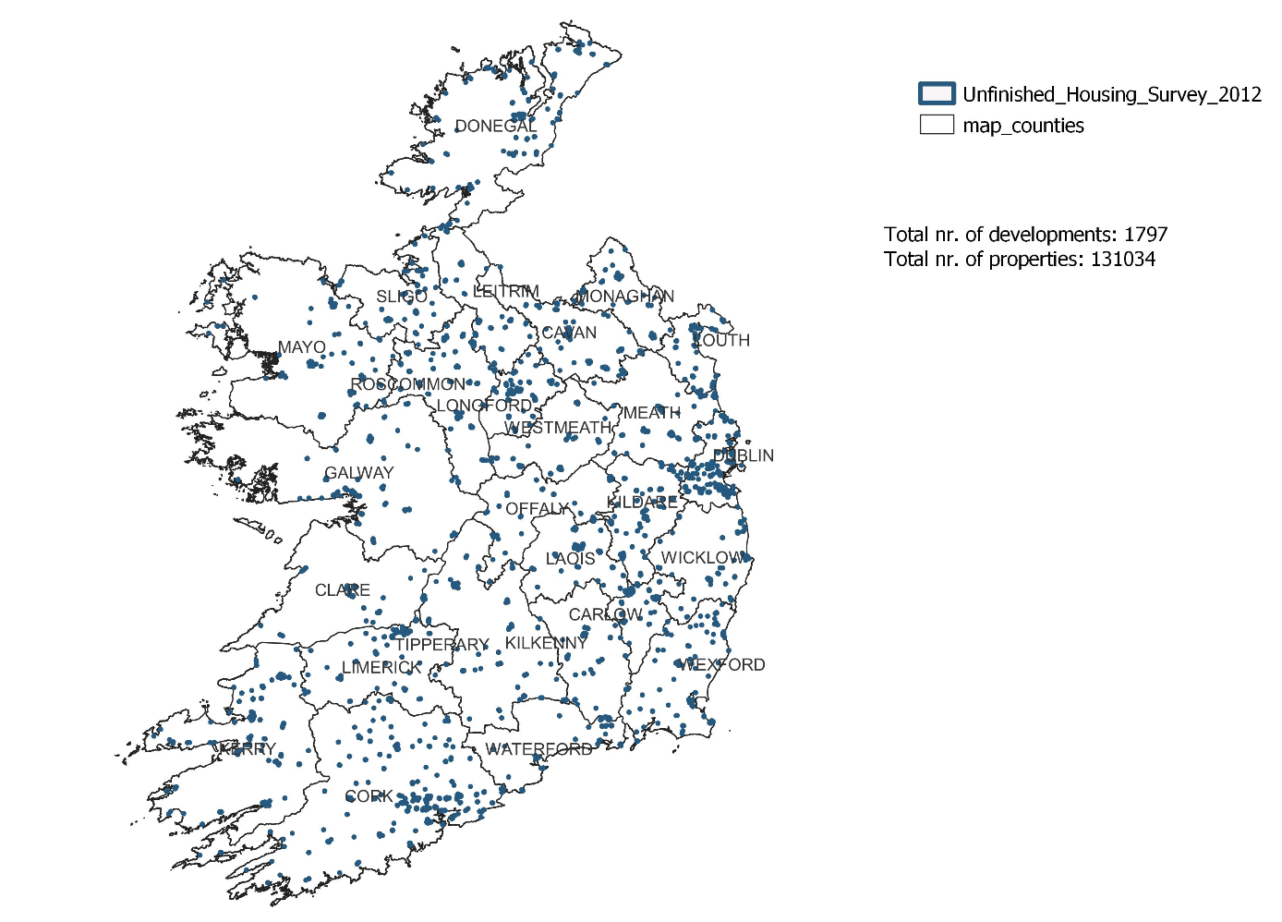
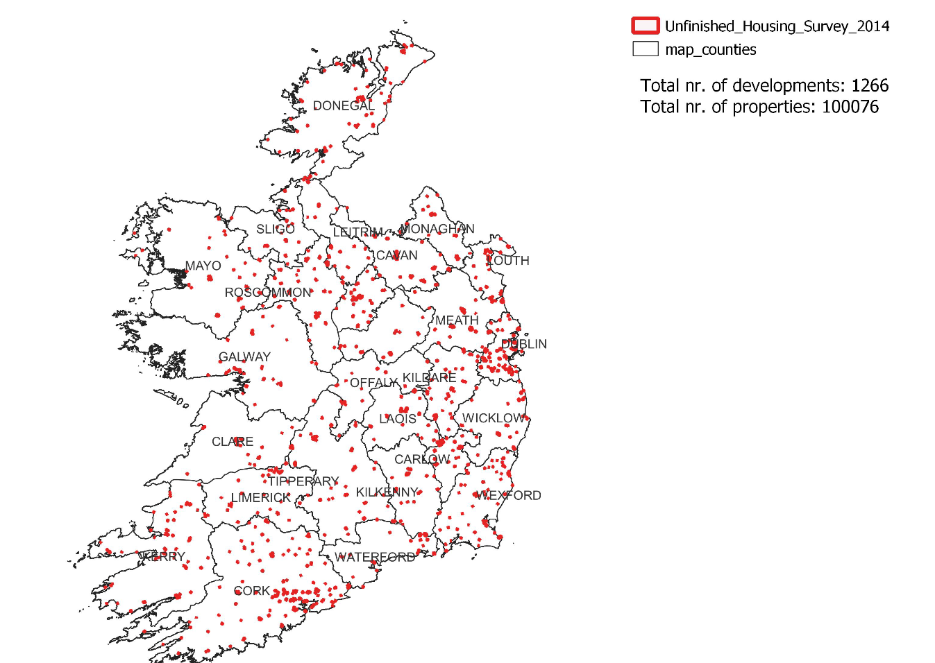
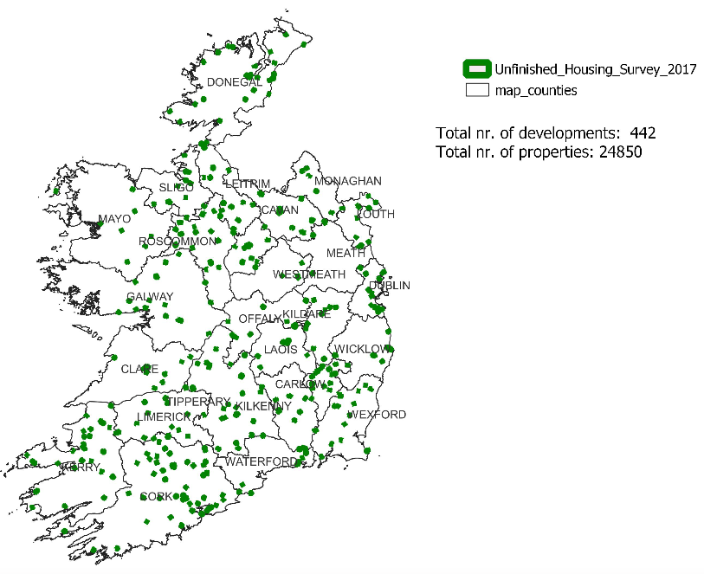
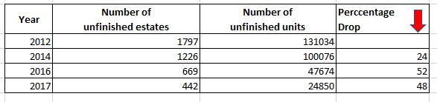
Location of unfinished estates, Republic Ireland 2012-2017 , QGIS

Slide 3
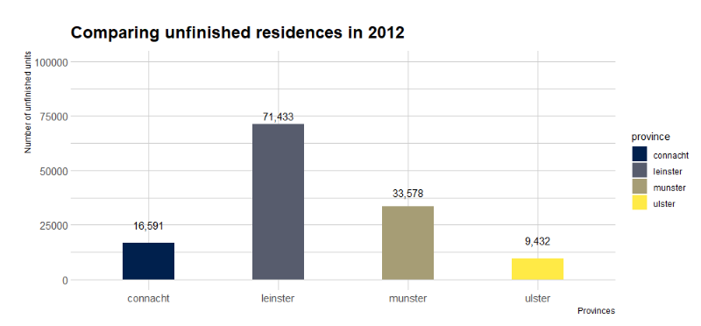
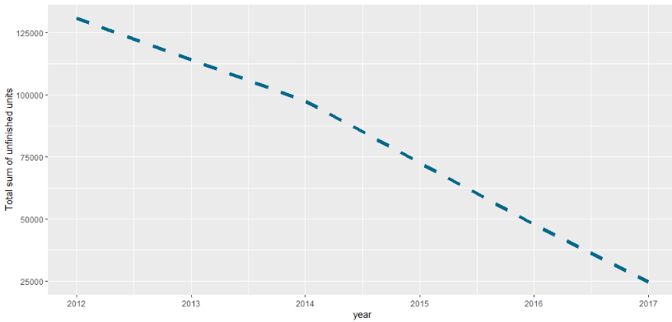
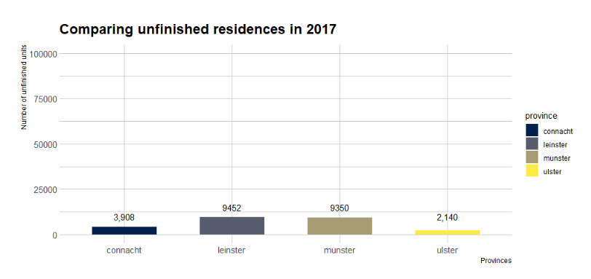
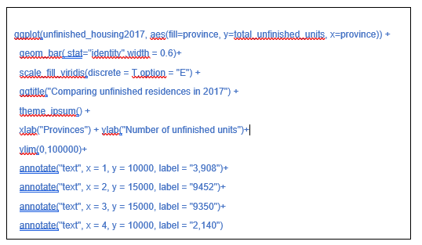
Trend of total housing between 2012 and 2017

Slide 4
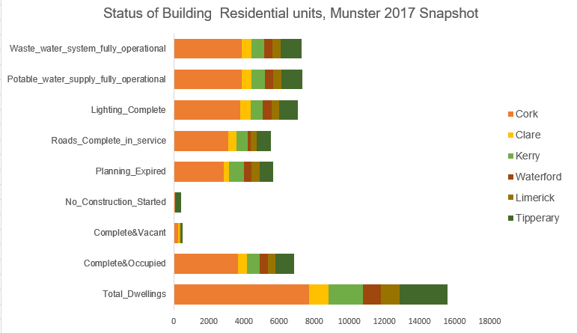
-nearly 16,000 total dwellings in Munster in 2017.
-Of these nearly half were complete from a construction point of view and occupied
-Less than 2000, of the 16,000 had not started construction and another 2000 were complete, but not occupied
-For half of the 16,000, it is visible that the basic critical services are in places such as waste water, potable water, lighting and roads
Status of critical services, focus on Munster region

Slide 5
